Slide 1

CYBER SECURITY DOMAINS
Presentation by team-9

Slide 2
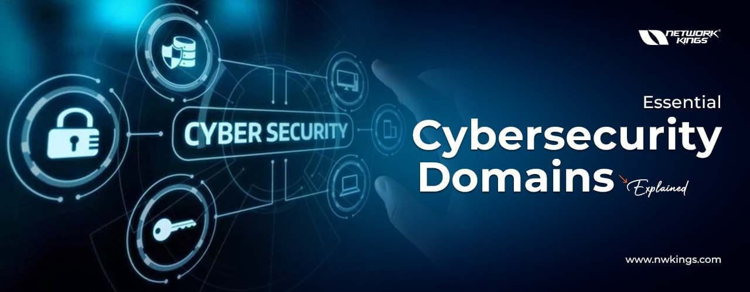
INTRODUCTION TO CYBER SECURITY DOMAINS
In today’s digital world, cybersecurity plays a crucial role in protecting sensitive data, networks, and systems from cyber threats.
Cybersecurity is a broad field, encompassing multiple domains that work together to ensure security across various digital environments.
The field of cybersecurity is structured into several key domains, each focusing on specific aspects of security to collectively safeguard

Slide 3
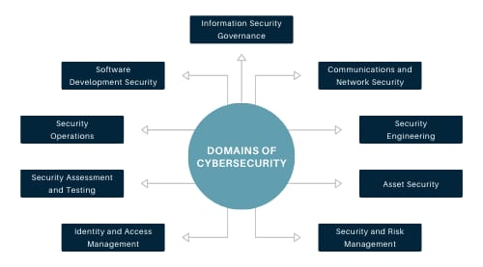
Cybersecurity domains

Slide 4

Cyber security domains includes:
Network security
Risk management
Security operations
Cryptography
Application security
Identity management
Threat intelligence
Asset security

Slide 5

Network security
Definition: Protecting networks from unauthorized access, cyber threats, and data breaches.
Importance: Ensures confidentiality, integrity, and availability of data.
Prevents Cyber Attacks: Shields against hacking, malware, and phishing.

Slide 6
RISK MANAGEMENT
Introduction to Risk Management
Definition: Risk management involves identifying, assessing, and prioritizing risks followed by coordinated efforts to minimize, monitor, and control the probability or impact of unfortunate events.
Importance: Effective risk management can help businesses avoid potential financial losses, legal liabilities, and damages to their reputation, ultimately contributing to their long-term success and stability.
Safety and Security
Workplace Safety: Identifies hazards and implements safety measures to protect employees from accidents and injuries.
Data Security: Protects sensitive information from cyber threats and data breaches.

Slide 7


Security operations
Security operations, often referred to as SecOps, encompass a set of practices and tools designed to maintain and enhance an organization's cybersecurity posture.
The goal is to protect against threats, vulnerabilities, and attacks by integrating security measures with IT operations.

Slide 8
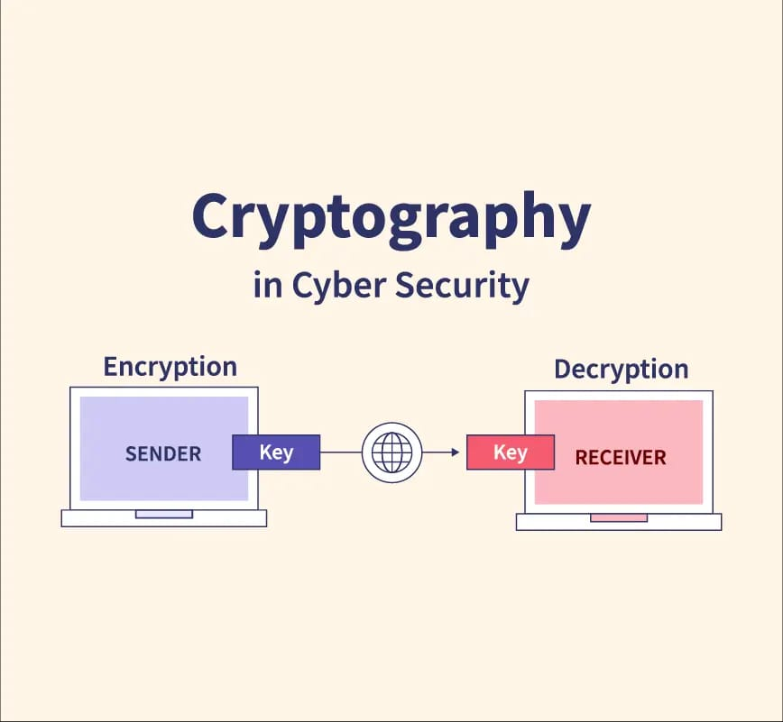
Cryptography
Cryptography is a fundamental aspect of cybersecurity, playing a crucial role in protecting sensitive information from unauthorized access.
Cryptography is the practice of encoding information so that only authorized parties can access and understand it. It involves converting plaintext (readable data) into ciphertext (encoded data) using algorithms and keys.
The process of converting plaintext to ciphertext is called encryption, and converting it back to plaintext is called decryption

Slide 9
Application security
Application security refers to the process of making applications more secure by identifying, fixing, and preventing security vulnerabilities.
It's a critical aspect of cybersecurity aimed at protecting software applications from threats and ensuring they operate securely.
Application security offers numerous benefits that extend beyond just protecting the software itself.
Protection of Sensitive Data
Reduced Risk of Attacks
Cost Savings
By implementing robust application security practices, organizations can safeguard their digital assets, maintain customer trust, and ensure the reliability and performance of their applications.

Slide 10
Identity management
Identity management in cybersecurity, also known as Identity and Access Management (IAM), is a critical practice that ensures only authorized individuals have access to the right resources at the right times.
Benefits of Identity Management in Cybersecurity
Enhanced Security
Operational Efficiency
Better User Experience
Risk Management
Cost Savings
Enhanced Trust

Slide 11
conclusion
Cybersecurity encompasses multiple domains, each playing a crucial role in protecting digital assets, networks, and sensitive information. From network and application security to cloud security, threat intelligence, and governance, every domain addresses specific challenges in the evolving cyber landscape.
As cyber threats grow in complexity, organizations and individuals must adopt a multi-layered security approach, leveraging best practices, advanced technologies, and compliance frameworks.
Continuous learning, proactive threat detection, and robust security policies are essential to mitigating risks
Cybersecurity domains work together to protect digital systems, networks, and data from threats.
Each domain focuses on specific areas, such as network security, application security, cloud security, and incident response

Slide 12
THANK YOU

